Slide 1

GILO
GLOBAL IDEAS LOCAL IMPACT
THE AI-POWERED FUTURE OF CONSULTING FOR SMALL BUSINESSES & NGOs
Investor presentation | Jan 2024
Notes:
Comment: In general, we can improve formatting further

Slide 2
THE PROBLEM
Traditional consulting overlooks small businesses, stifling innovation
400M
Small businesses globally
49%
Not hiring experts
50%
Fail Within 5 years
Small businesses face an Innovation & Consulting crises
HIGH COST OF TRADITIONAL CONSULTING
"I can't afford big names"
LIMITED ACCESS TO EXPERTISE AND SUPPORT
"I don't know how to find them"
DIFFICULTY FINDING THE RIGHT EXPERTS
"I don't know which solution is the correct fit for us"
LACK OF TRANSPARENCY AND ACCOUNTABILITY
"I don't know how and if it works"
Refrences
https://smallbusiness.co.uk/uk-smes-expert-consultants-2538135/
https://assets.publishing.service.gov.uk/government/uploads/system/uploads/attachment_data/file/1185260/Small_Business_Survey_2022_-_Panel_Report.pdf
Notes:
For discussion:
Where did you get these data from – 400m, 49%. 50%? Particularly this 49%

Slide 3







CONSULTING 2.0
The AI-powered future of consulting & freelancing for small businesses & NGOs
GILO
Needs of small businesses & NGOs
Consulting 1.0
Freelance Consulting 2.0
Focused on small business & NGOs
Freelance 1.0
AI
Notes:
I think before we go into AI capabilities, we need a more general page to answer what is GILO? What is the solution we are addressing the problem we mentioned previous page, what is our vision?

Slide 4


HOW GILO WORKS?
GILO
GAINSHARE MODEL
Bigger earnings based on impact
Pay based on tangible results
Upload existing Ideas/portfolio (or)
Explore more problems to help solve
AI Handles
business problem identification
matching to right experts
KPI governance
Legal documentation
INNOVATORS
Consultants
Influencers
Fundraising experts
Financial experts
Analytics experts
digital experts
SMALL BUSINESSES
(0-100 Employees)
<$5M Turnover

Slide 5









THE UNIQUE VALUE PROPOSITION
Gilo disrupting the incumbents, so what sets us apart?
ADDRESSES HUGE UNMET SME MARKET NEEDS
AI-POWERED, END-TO-END CUSTOMER JOURNEY
PERFORMANCE-BASED PRICING MODEL
ANALYTICS DASHBOARD TO MONITOR SUCCESS
FEEDBACK LOOP TO MAKE AI EVEN SMARTER
AFFORDABILITY
ACCOUNTABILITY
GILO
EASE OF ACCESS
QUALITY

Slide 6


THE GILO AI ENGINE An end-to-end customer journey, powered by AI
SMALL BUSINESS
GILO AI
"the brain"
AI UNDERSTANDS REQUIREMENT
AI UNDERSTANDS SKILLS
INNOVATOR
Onboarding |
Conversational AI for better customer engagement and formulation of requirements
Matching |
Advanced AI algorithm for optimized matching
Contracting |
AI-generated gainshare contract, and recommendation on KPI framework
Monitoring |
Analytics dashboard for KPI governance
GAINSHARE PAID on results
Real-time feedback enhances AI performance
GAINSHARE RECEIVED
On results
Feedback |
Notes:
For discussion:
What do we exactly mean by innovator? Shall we replace with Experts for easier understanding
I revised formatting a bit, it is better to spell out each stage of customer journey as it is clearer
will need to give some more thinking about if better layout in the morning

Slide 7
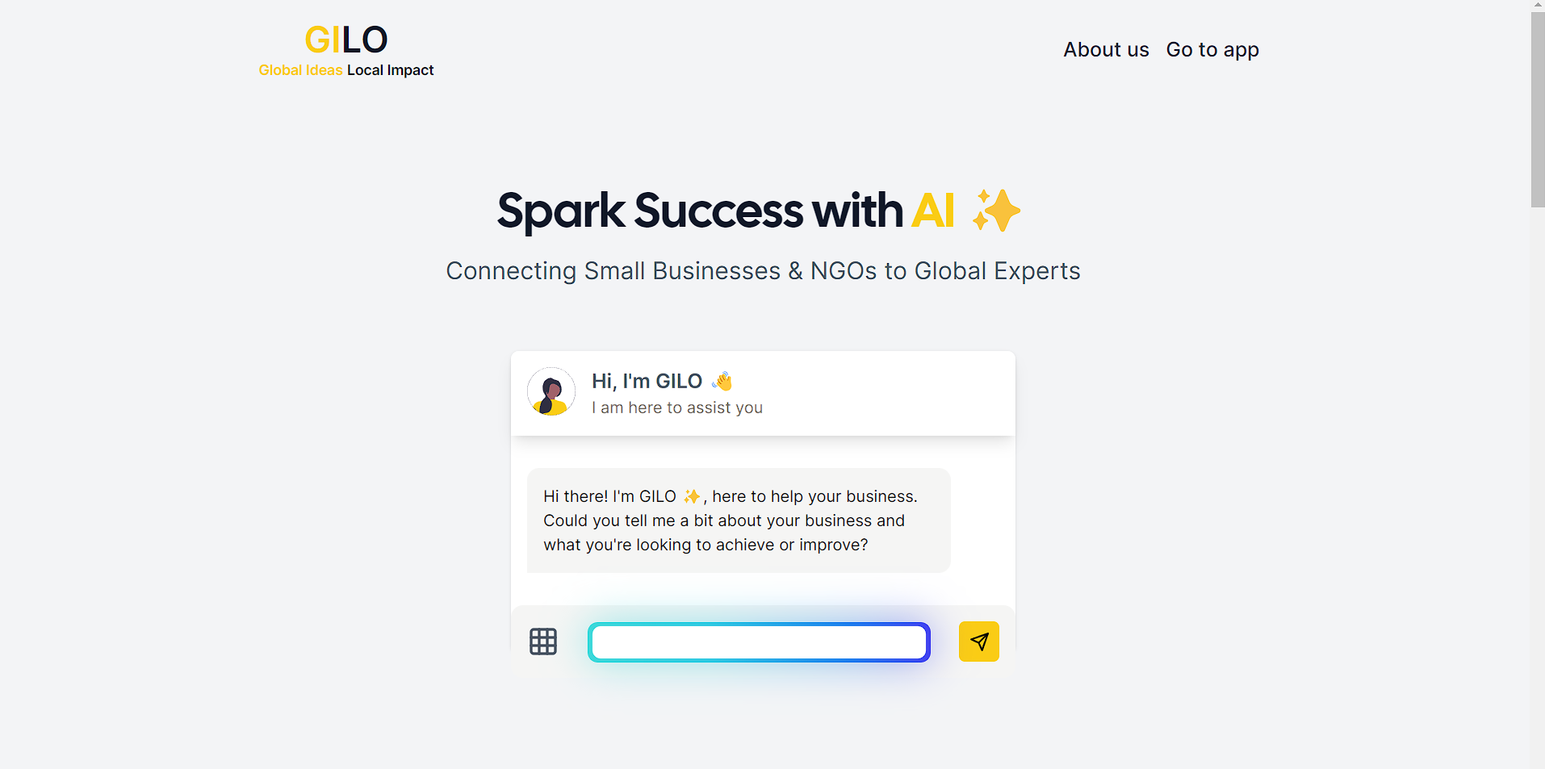

THE PRODUCT DEMO (BETA)
Let the fun begin!

Slide 8
THE MARKET OPPORTUNITY
Large TAM and further white space bring significant revenue potential
POTENTIAL ADDRESSABLE MARKET SIZE
5 Years OF LAUNCH
$308B
Global Consulting market
$6B
10% penetration in existing market
$2B
10% of Untapped Market
49% of SB don’t hire experts
$8B
$60B
Small Businesses Consulting
$80M
1% Service charge
To GILO
Y5 Revenue
*Additional revenue from gainshare not calculated
https://www.mordorintelligence.com/industry-reports/consulting-service-market
Notes:
Let's discuss this:
1000 small businesses for 2024 target? seems really big push. Isn't from next page, product only launch in 2025?
The $11m revenue by when?

Slide 9

THE ROADMAP
Clear path to launch and commercialize products in 24M, with limited upfront investments
2024
2025
2026
AI developer
Full Stack Developer
Alpha
Pilot
UK Launch
Global Launch
Concept validation
GTM + Legal Expert
Investment opportunity
We need a £3000 investment to support the development of the AI tools and platform further for a pilot run
2024
2025
2029
PILOT RUN
Product Launch
Revenue $80million+
Notes:
Question:
Previous page says $11m revenue, here we say £11m profit, how do they link?

Slide 10


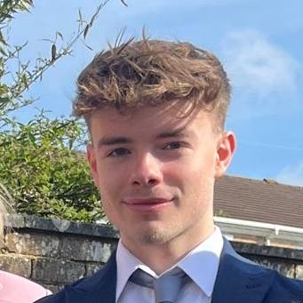





THE TEAM
A highly self-motivated team with diverse skillsets
SAHIB SINGH
ECHO ZHAO
ETHAN HOSIER
Computing Undergraduate
MSc in Artificial Intelligence

Slide 11
APPENDIX

